Slide 1
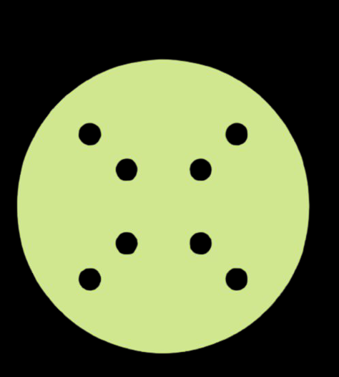
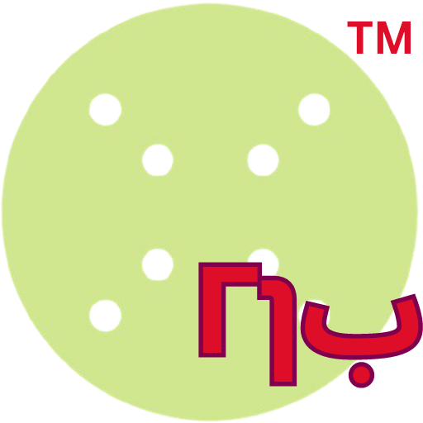

Monday.Com AI Hackathon
QGib
Monday.Com

Slide 2
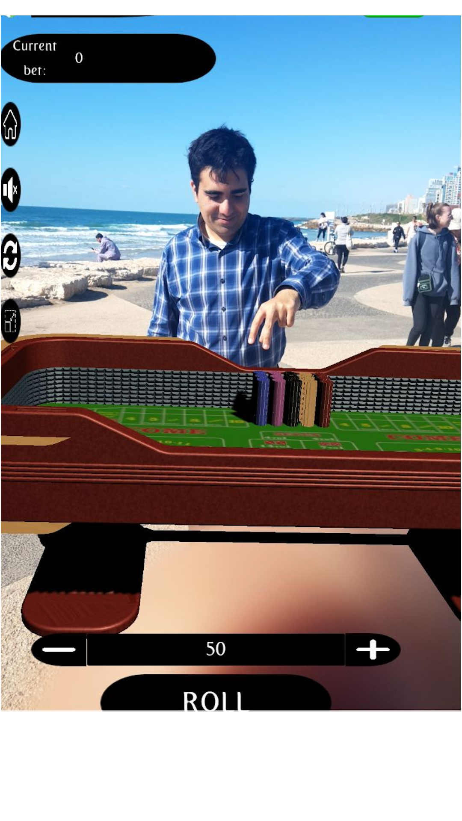
QRoulette
Hi! I am Or
I am a Unity Developer, expert in Extended Reality, published six AR Games at the Store, and recently got into JavaScript, Chrome Extensions and well… Monday.Com Marketplace AI App ☺

Slide 3
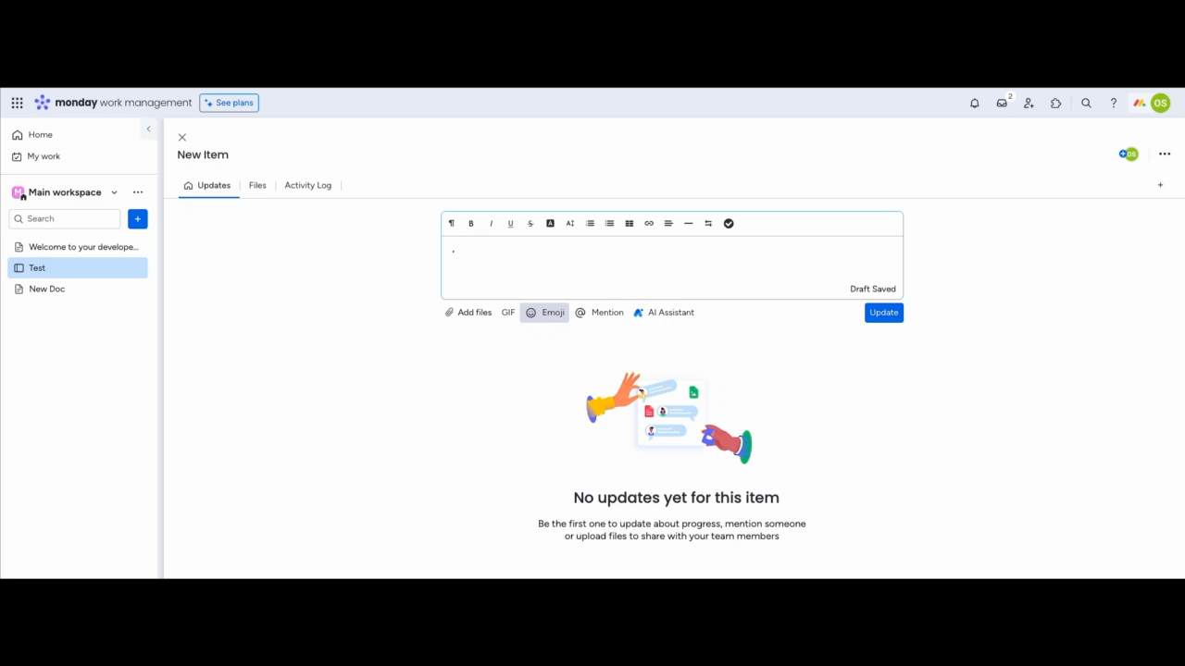
What’s the problem?

Slide 4
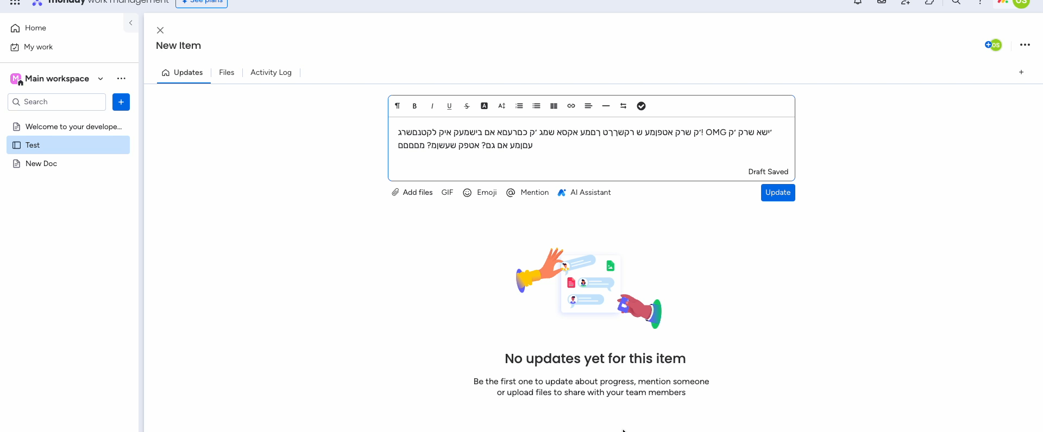
We found a solution!
Introducing QGib

Slide 5

QGib is open source!
* Support for additional languages coming!
* More cool features by the community
* Benefits from wisdom of the crowd
* Genuine and trustworthy!

Slide 6
QGib supports conversion between English, Arabic and Hebrew
QGib was designed to allowing you to convert your text between all supported languages seamlessly, using sophisticated data structures and optimized searching algorithms for them!
Even better, adding languages to QGib, will be easy, thanks to a modular design of the code!

Slide 7
One more thing?...

Slide 8
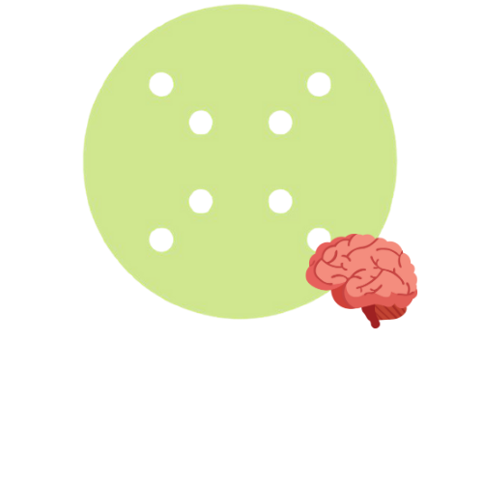
Introducing QAI Al-Safa

Slide 9
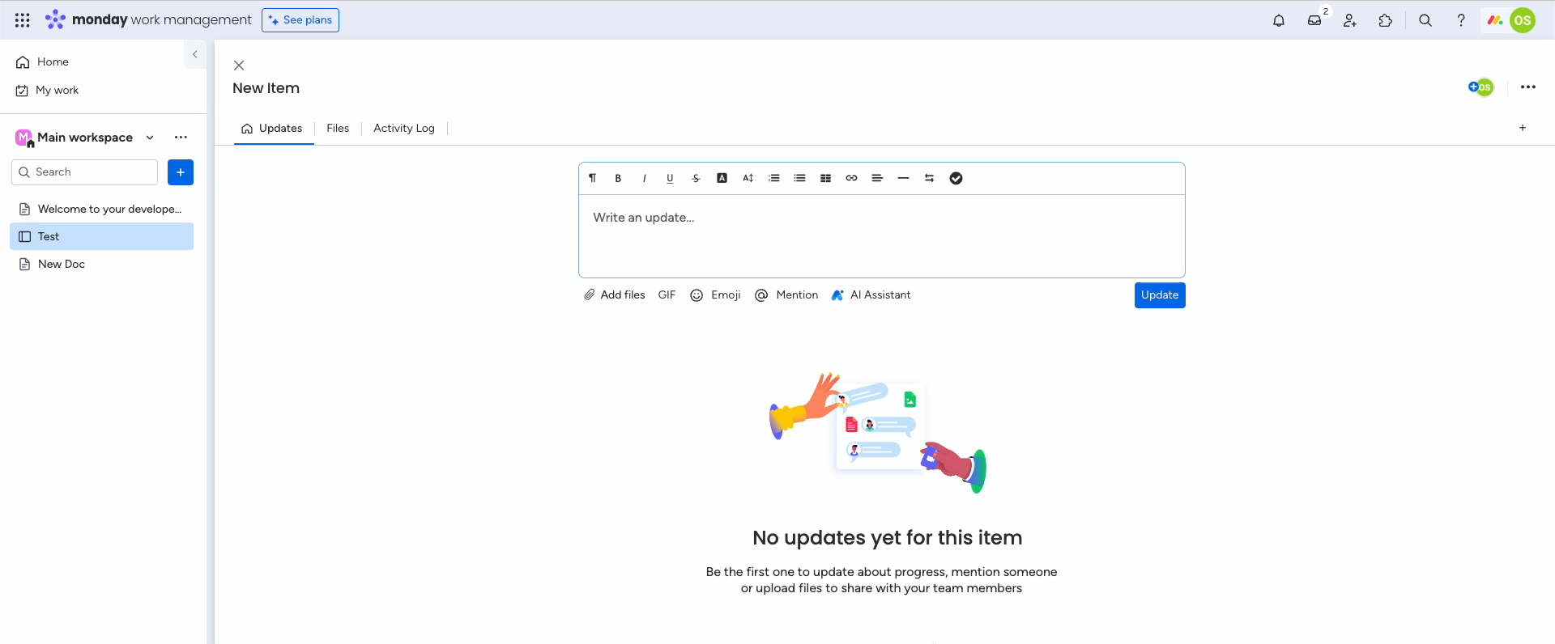
Offers an alternative rephrase
of the customer text

Slide 10
QAI Al-Safa is Cucumber’s first AI Product
I am proud to integrate a revolutionary API
By OpenAI!

Slide 11

Type Better! Type $limitless!$
https://www.linkedin.com/in/orsn/

